Slide 1


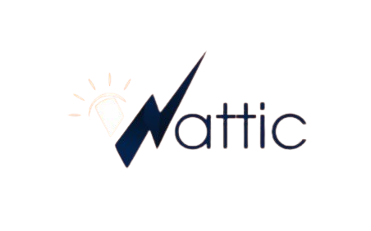



Powering Efficiency | Ensuring Reliability | Monitoring Consumption | Reducing Costs
Wattic Energies
Solutions Brochure
Revolutionizing Africa’s Energy Consumption & Monitoring Experience.
www.watticenergies.com

Slide 2


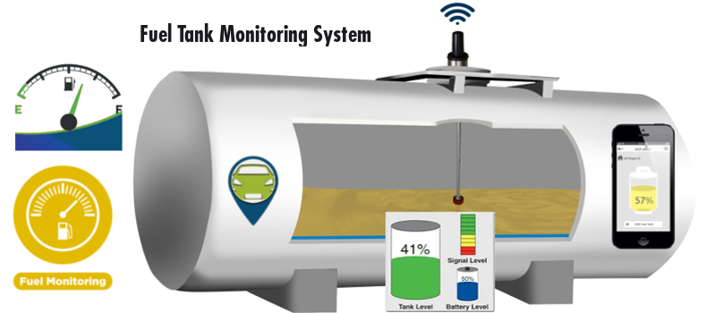
Who We Are
Wattic Energies is an indigenous innovative energy efficiency solutions company that is revolutionizing Africa’s energy consumption and monitoring experience. We deploy intelligent IoT technologies, energy saving solutions, advanced monitoring sensor technologies, and intuitive software solutions for real-time management and monitoring of energy resources. Our solutions are specially designed for the general business sector using energy, recidential facilities and the downstream oil & gas industry.
We are transforming how businesses and industries across all sector, together with residentials across Africa manage and reduce their energy consumption, track consumption, monitor petroleum products inventory (storage or on transit), and reduce operational cost.
High energy costs, unreliable supply, national grid/diesel dependency, fuel theft or wastage, highway petroleum product theft, and environmental concerns are serious issues today. In the interception of all these concerns and needs is where Wattic Energy was founded, to bridge that inadequate monitoring and high cost gap for every managers, directors, stakeholders and home owners.
www.watticenergies.com

Slide 3


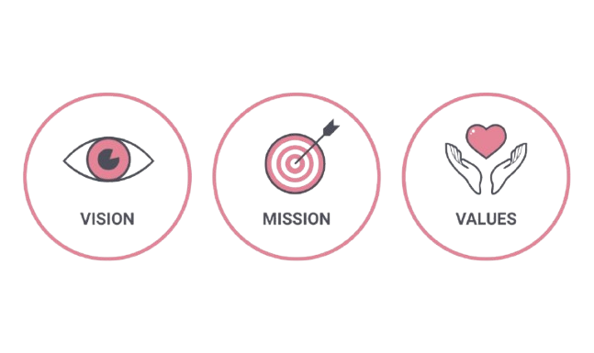
Our Identity
Our Vision
To make energy efficient, transparent, monitorable, reliable, and clean energy the standard for all businesses and homes in Africa.
Our Mission
To deliver smart energy solutions that cut costs, boost reliability, reduce environmental footprint, and provide real-time intelligence in fuel and power usage.
Core Values
Innovation | Reliability | Transparency
customer-Centric | Technology Leadership | sustainability

Slide 4

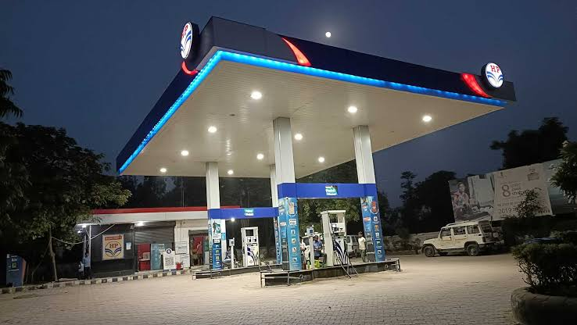



The Challenges
Energy cost remains one of the factors that impacts the profitability of most organizations negatively as it tends to shoot up operational cost by 30%+. From electricity bill down to diesel/fuel consumption in generators/vehicles, and also storage tanks, fuel pumps & trucks.
Industries, facilities, estates and homes spending heavily on their energy consumption due to high electricity tarrif just to keep operations running.
Unreliable national grid and high diesel generator operation cost due to ever-increasing diesel price, discripancies, and thefts.
Manual inventory check for storage tanks in facilities across business areas and residentials which leads to manipulated data capturing.
Filling stations/LPG plants loosing big time to poor pump monitoring and underground tank real-time tracking.
Petroleum marketers, logistics and haulage companies loosing big as a result of fuel theft on highways through tank drain.
Vehicle owners, fleet managers, and logistic companies not trusting drivers with their vehicle fuel tank due to theft.
www.watticenergies.com

Slide 5
Our Key Solutions
What We Offer
Smart Tank Technology
Solar Generator
Downstream Oil & Gas Management System
Starking Energy Saver
Oil & Gas Inventory Management Outsourcing

Slide 6

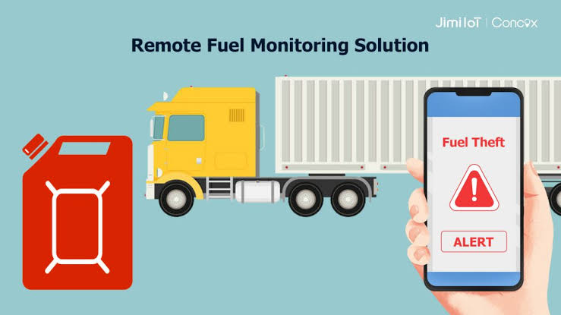

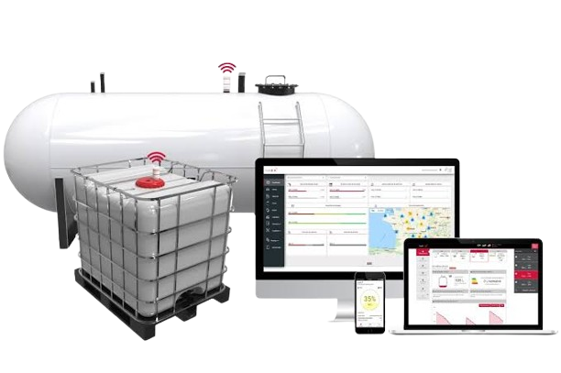

Smart Tank Technology
The Smart Tank Technology is a real-time diesel inventory monitoring and management system designed for businesses and homes with diesel tanks. It eliminates diesel theft, manipulation of data, shortages in supply, and the inefficiencies of manual inventory checks by providing 100% visibility, real-time monitoring, consumption pattern, alerts and notifications, accountability, and security of stored diesel, all from one dashboard. Our sensors are highly intelligent to transmit on-the-go information to keep you updated on how every litre of diesel in your tank is consumed, giving you full control of your diesel inventory.
What Smart Tank Technology Solves
Provides real-time monitoring of fuel levels across tanks.
Prevents theft and eliminates manipulation of inventory data.
Sends alerts for low levels, sudden drops, or irregularities.
Enhances supply chain management and inventory accuracy.
Benefits
Eliminate diesel theft and pilfering.
Ensure uninterrupted operations with real-time monitoring.
Reduce cost wastage by tracking every liter consumed.
Improve accountability between management, staff, and suppliers.
Save money by stopping fuel leakages and supply manipulation.
Who is the Solution for?
Businesses running diesel-powered generators.
Hotels, hospitals, schools, and estates with central fuel tanks.
Industrial facilities and factories dependent on diesel.
Fuel-intensive businesses (logistics, OOH advertisers, data centers, construction, oil servicing).
www.watticenergies.com

Slide 7
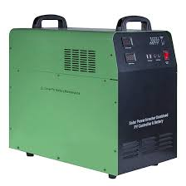
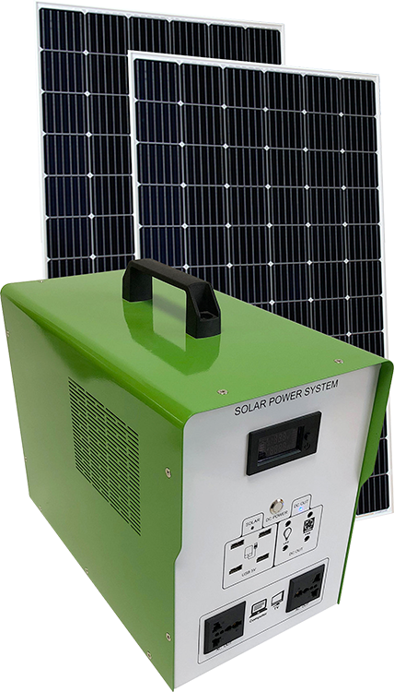

Solar Generator
The Solar Generator is Wattic Energies’ renewable energy solution that enables homes and businesses to switch to Band-S (self-sufficient solar power), cutting dependence on the unreliable national grid and expensive diesel generators. It provides clean, consistent, and cost-saving electricity to ensure uninterrupted productivity. Our solar generators are custom built to meet your energy needs and run time. We have been able to meet our 18hours solar system run-time promise to our users across different industries and currently working on an upgraded system that guarantees 24hrs energy supply even when there is no sun light. We are on a mission to make fueless generators a true reality in Africa.
What the Solar Generator Solves
Provides a reliable and consistent power alternative.
Eliminates high fuel costs and generator maintenance expenses.
Reduces downtime, ensuring continuous productivity.
Helps transition businesses and homes to renewable energy (Switch to Band-S).
Benefits
Zero dependency on national grid and costly fuel generators.
Significant reduction in operational costs.
Continuous electricity for 24/7 operations.
Contribution to climate-friendly renewable energy adoption.
Long-term savings and energy independence.
Who is the Solution for?
Homes seeking independence from erratic national grid supply.
SMEs, corporate offices, and industries with high energy needs.
Schools, hospitals, hotels, and estates where downtime is costly.
Environmentally conscious consumers seeking clean energy.
www.watticenergies.com

Slide 8
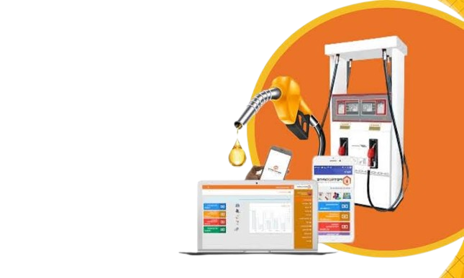
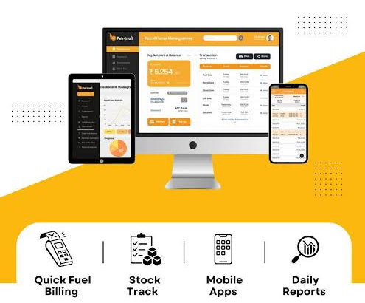
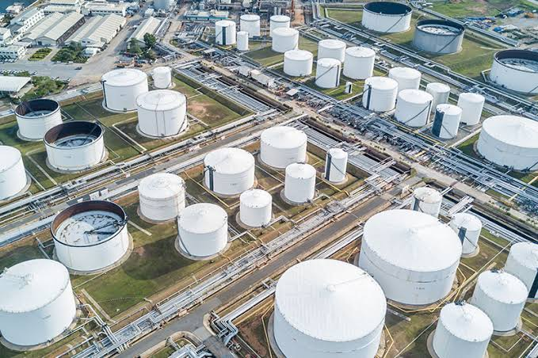
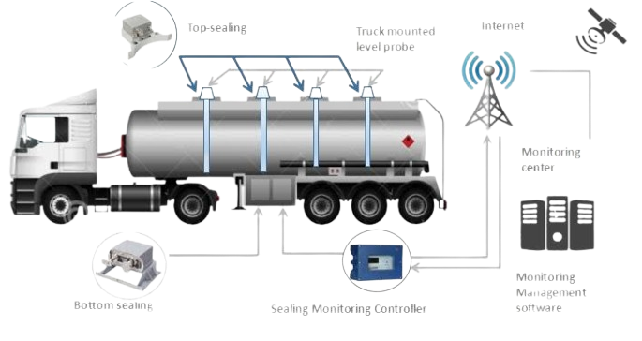
Downstream Oil & Gas Management System
Wattic’s Oil & Gas Management System is a robust digital solution designed for downstream oil and gas businesses. It centralizes the monitoring and management of resources, sales, tanks, pumps, personnel, trucks/tankers, and accounts. Whether at a filling station, LPG plants, depot, head office, or tank farm, this system ensures efficiency, productivity, transparency, and profitability. Our system have different modules which caters for Tant Management, Pump Management, Nozzle Management, Sales Volume Management, Supply Management, Sales Attendants/Shift Management, Truck Management, Central/Head Office Control Dashboards, Depot Management System, Transportation Management and so on. Our robust system ensures you run a seamless, profitable and monitorable oil & gas downstream business operations.
What the Oil & Gas Management System Solves
Provides end-to-end visibility of fuel distribution, sales, and stock.
Tracks truck/tanker movements in real time.
Prevents fraud, leakage, and losses in downstream operations.
Streamlines operations with automated monitoring and reporting.
Benefits 
Eliminate fraud, leakages, and supply losses.
Improve accountability across all levels of operations.
Increase operational efficiency and profitability.
Centralized control for multi-location businesses.
Enable smarter business decisions through real-time analytics.
Who is this Solution for?
Filling stations, LPG plants, and retail fuel outlets.
Depot owners and tank farm operators.
Downstream oil and gas companies.
Corporate headquarters managing multiple fuel stations/LPG outlets.
www.watticenergies.com

Slide 9
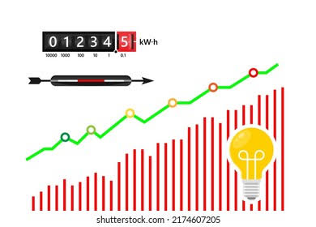
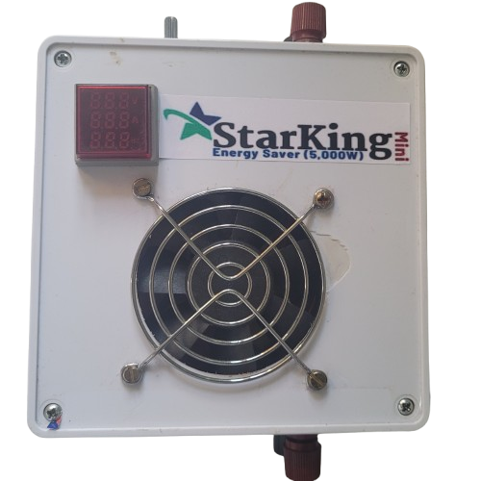
Starking Energy Saver
The Starking Energy Saver is a cutting-edge energy optimization device designed to reduce electricity consumption by up to 30% across homes and businesses. It optimizes load efficiency, reduces wastage, and extends battery runtime in solar power systems. For heating loads, it delivers up to 50% energy savings, making it a must-have for both residential and commercial applications. We custom build our solution to suit your energy consumption capacity (from 5,000W up to 200,000W energy saving system). Our energy saver is installed in-between your energy source and your loads without tampering on the energy coming from the source. Our device only work on the load, reduce the amount of current it draws from the energy source, thereby reducing your electricity consumption and cost.
What the Starking Energy Saver Solves
Cuts down excessive power wastage and reduces bills.
Extends battery storage life for solar-powered systems and increases run-time by 2 hours or more.
Provides a cost-effective solution for homes and SMEs struggling with energy expenses.
Enhances power efficiency without affecting appliance performance or tampering on energy source.
Benefits
Save 20–30% on electricity bills consistently.
Extend solar battery lifespan and runtime.
Easily installed with little or no maintenance
Reduce operational costs for heating-heavy businesses.
Improve sustainability and energy efficiency.
Quick return on investment through monthly energy savings.
Who is this Solution for?
Homes with high electricity bills.
Businesses and SMEs running on solar and grid supply.
Manufacturing firms and facilities using high-power heating loads.
Facility managers, property owners and landlords seeking reduced energy overheads.
www.watticenergies.com

Slide 10
Implementation Process
1
2
3
Initial Consultation & Audit
Solution Design
Hardware/Software Installation
Understand your current usage/parameters, costs, and unique needs.
Tailored solution development and deployment.
Sensors, IoTs, Flow Meters, servers, solar systems,, and dashboards.
6
5
4
Support & Maintenance
Monitoring & Optimization
Training & Onboarding
Remote diagnostics, maintenance, and support.
Ongoing reports, analytics, and alerts for informed decisions.
For Directors, Stakeholders, managers, operators or admin staff.

Slide 11


Our Competitive Advantage
Deep local expertise and understanding of African energy/oil & gas infrastructure and constrain.
Integrated solutions that works for every industry.
Real-time monitoring and analytics
Custom deployment based on core needs
Affordable and flexible financing & support.
Sustainability and compliance built-in.
Proven track records.
POC (proof of concept) deployment on request.

Slide 12
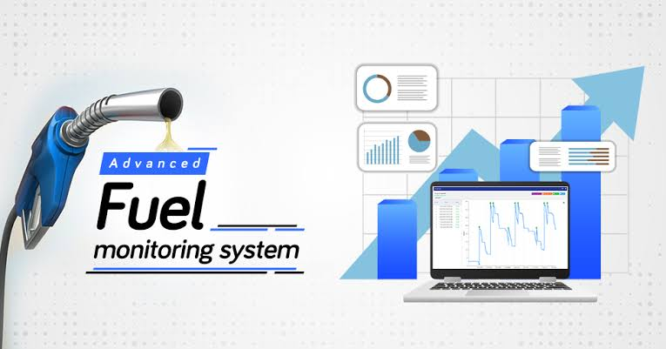
Who We Serve
01. Banks
02. Fuel Stations/Depots
03. OOH Advertisers
04. Haulage/Logistics Firms
05. Facility Managers
06. LPG Plants/Depots
07. Construction Companies
08. Property Developers
09. Hotels/Restaurants/Lounges
10. Factories/industries
11. Schools
12. Malls/Office Complexes

Slide 13

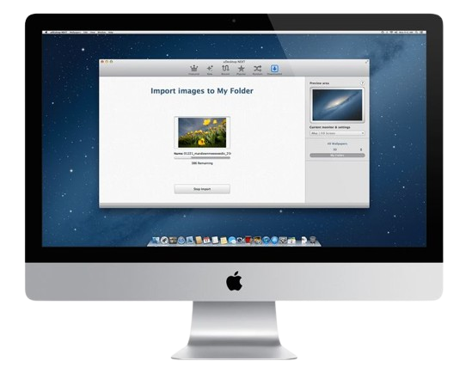
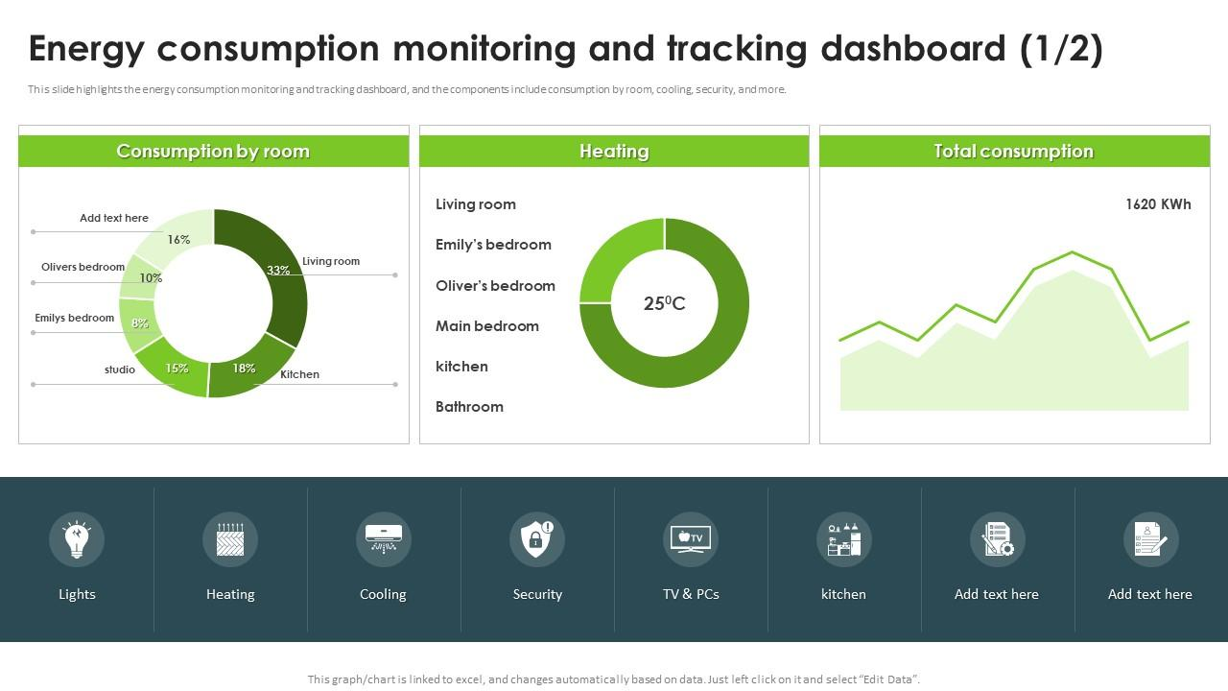
Our Commitment
Powering Progress, Together
Technology partnerships, not just transactions.
Timely support and long-term collaboration.
Solutions improvement to keep our client’s businesses running.

Slide 14
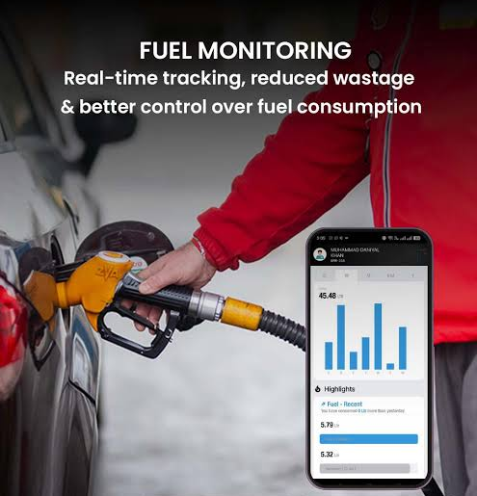



Let’s deploy solutions that improves your operational efficiency, increase profitability, and reduce cost.
Thank You
Contact Us
07064247400, 09038775464
9, Badaru Street, Jakande, Lekki Peninsula II, Lekki Lagos.
www.watticenergies.com

